Slide 1
Video and Survey Access

Slide 2
UCCS Simulation Center Web Page
Video access is at http://ems.ucs.edu/
Assistance can be found on the Simulation Center web page.
http://www.uccs.edu/~simcenter/

Slide 3
Simulation IQ Log on Page
Use your UCSS credentials to log into Simulation IQ. If you have problems playing a video try Internet Explorer as your browser.

Slide 4
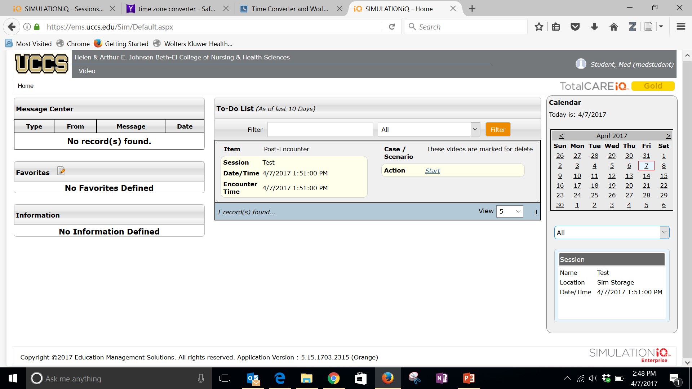
Simulation IQ Home Page
The home page has a link to take the surveys associated with your simulations.
Click the tiny start link to begin your survey.

Slide 5
Simulation IQ Home Page
The Home page also displays videos of your simulations.
You can see all the videos you have access to. Click the one you wish to watch.

Slide 6
Video Play Back
The next screen will play the video. You can change the camera view by click the links at the top of the video.

Slide 7
Beth-El Simulation Center
If you have any issues or questions please contact any of the Simulation Center Staff for assistance.
Tim Russom
Simulation Technician
255-4067
trussom@uccs.edu

